Slide 1
Group 6
Seong Hun Lee, Yazdi Jenie, Peng Lu, Manan Siddiquee, Martijn Bevernaegie, Cherry Cheung

Slide 2
Overview
Contents
Vision algorithm
Flight plan

Slide 3
Vision Algorithm
Simple detection of orange color for the poles, and black color for the wall
Color threshold is manually set for Cr and Y channel in YCbCr colorspace.
Using these color-thresholds, two binary maps of Cr and Y channel is computed. Then the width of the object is estimated and compared to a width-threshold.
If the object has larger width than the threshold → classified as “obstacle”.
Depending on the location of the obstacle (left or right), a decision is made to turn to the left, right, or straight ( in case no “obstacle” is detected)

Slide 4
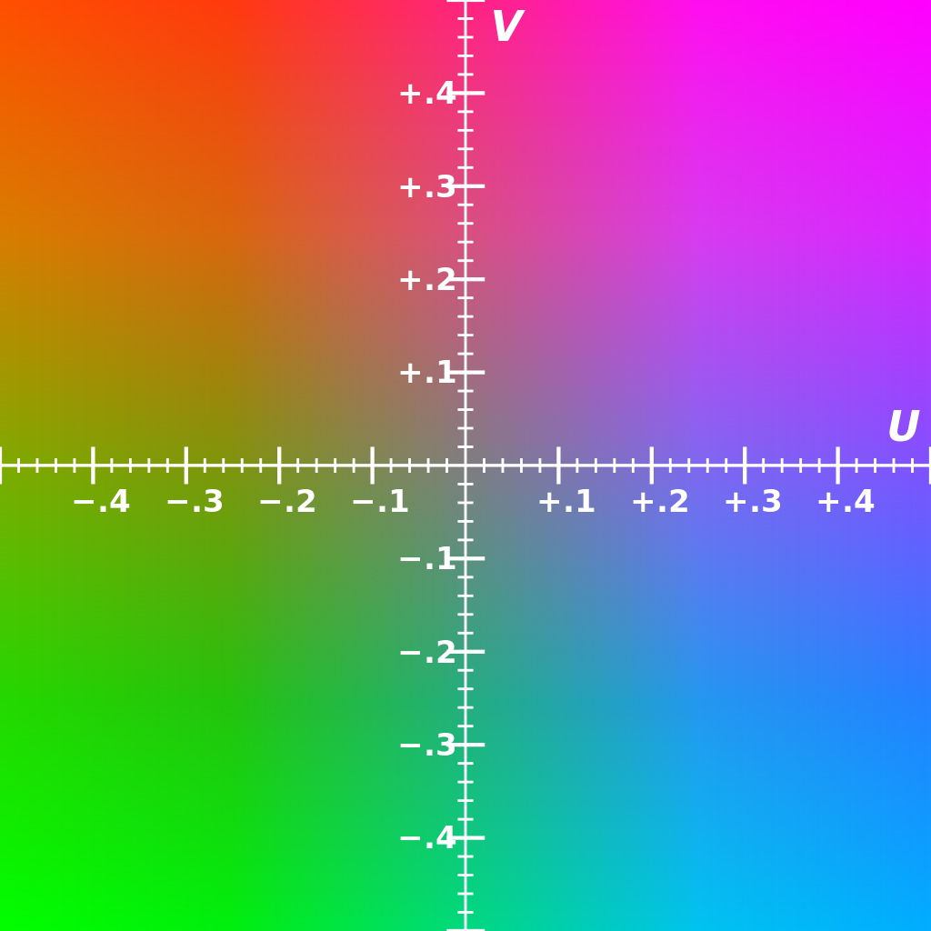
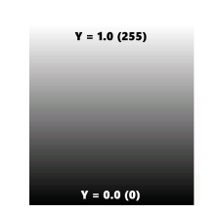
Vision Algorithm
Cr threshold
Y threshold

Slide 5
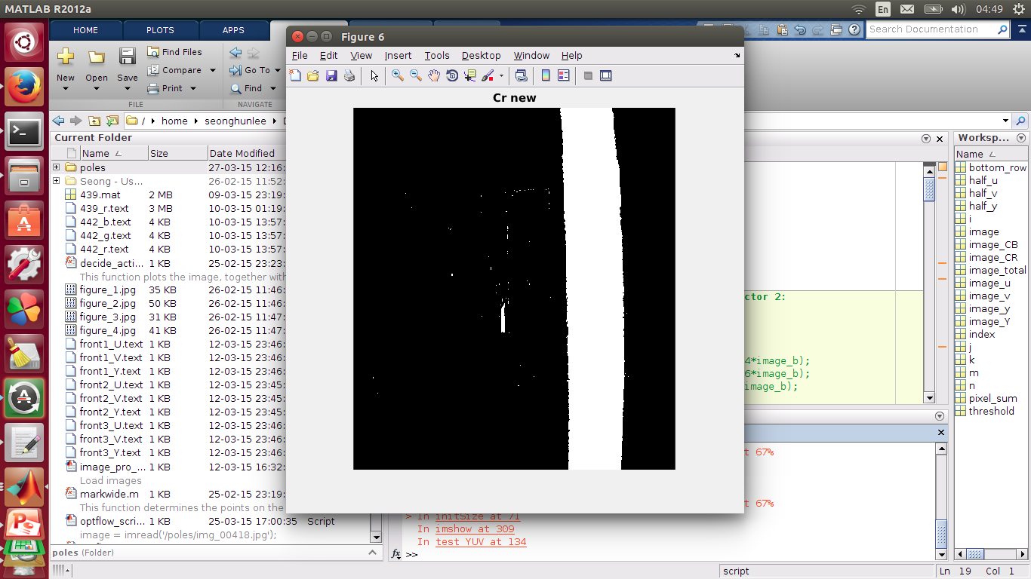
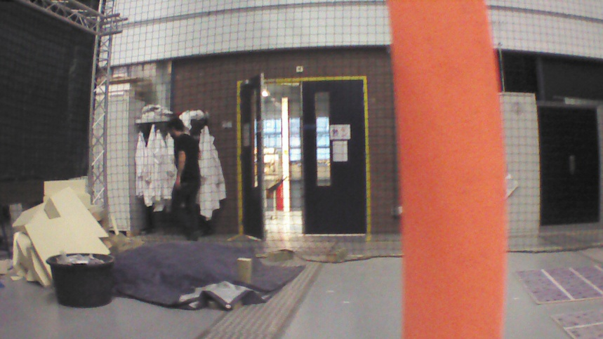
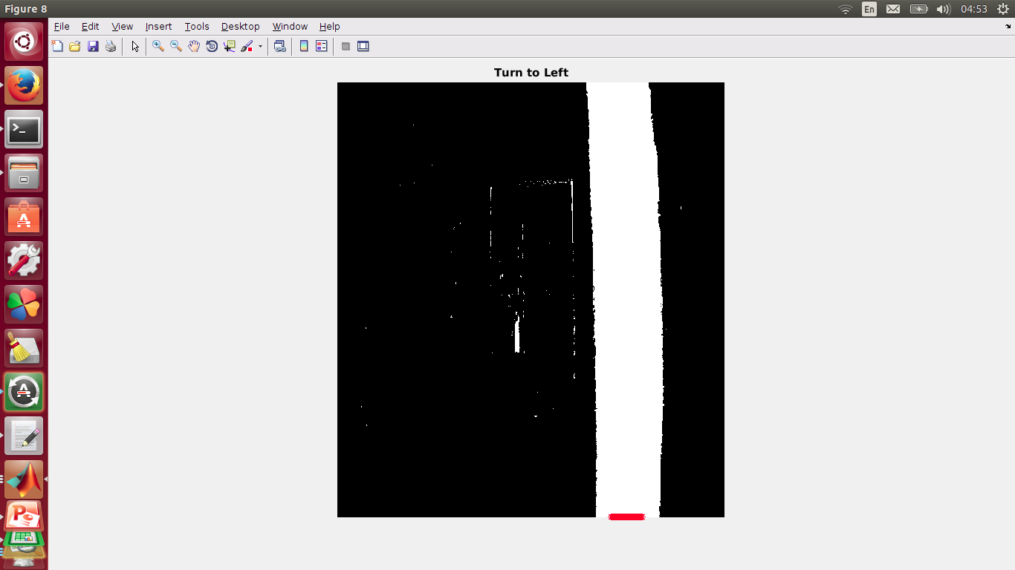
Vision algorithm
Note:
We only use the bottommost pixel row !!
Width (pixel) threshold

Slide 6
Vision algorithm dynamics
yes
Black wall
Do you see a black wall ?
    Yes: Turn to left or right
    No: go to (2)
Do you see an orange edge on the side ?
    Yes: Turn to left or right
    No: go to (3)
Do you see an orange pole nearby ?
    Yes: Turn to left or right
    No: go straight
no
yes
Orange
edge
no
yes
Orange
pole
no
Right
yes
no
RIGHT
1
LEFT
-1
STRAIGHT
0

Slide 7
Vision algorithm evaluation
Advantages:
  Fast → only bottommost pixel row with left, right and center pixels accessed (adjusted threshold)
  Handles static images (reactive)
  Easy to test and tune
Limitations:
  Performance very dependent on tuning of thresholds
  Slow for quad-rotor stability
  Static → cannot handle motion blurred
  Reactive (but can be advantage)
  Only works in the Cyberzoo environment with orange poles and black walls, with grey floor and dark background

Slide 8
Flight Plan
If the drone sees an obstacle and needs to turn to left (-1) or right (1):
(1) Stop
(2) Turn (1/-1) 45 deg x 2
(3) Set a new waypoint towards current heading
(4) Go
0
yes
no
yes
-1
inside
yes
no
no
LEFT
2x45º
RIGHT
2x45º
RIGHT
4x45º
STRAIGHT
0

Slide 9
Flight Plan
If the drone flies outside the flight area:
(1) Stop
(2) Turn 45 deg x 4
(3) Set a new opposite waypoint (with respect to the origin)
(4) Go
0
yes
no
yes
-1
inside
yes
no
no
LEFT
2x45º
RIGHT
2x45º
RIGHT
4x45º
STRAIGHT
0

Slide 10
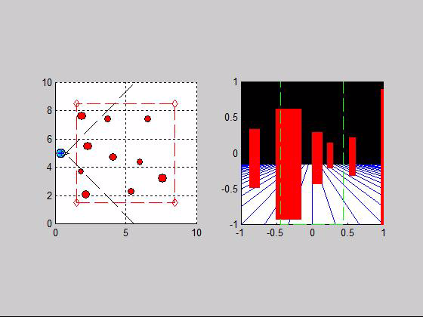
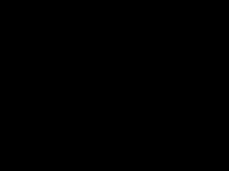
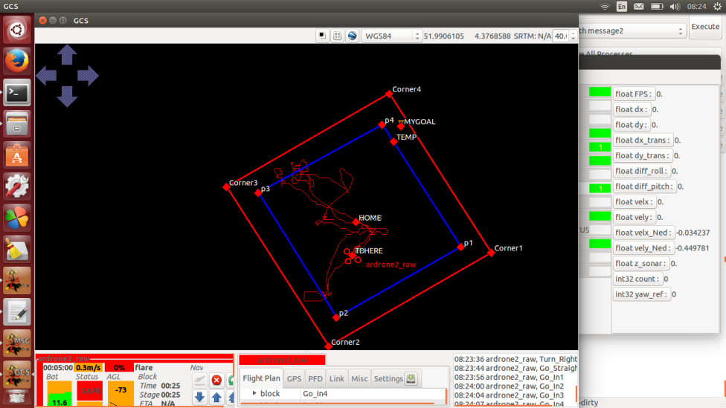
Testing – Simulation and Experiments

